Slide 1
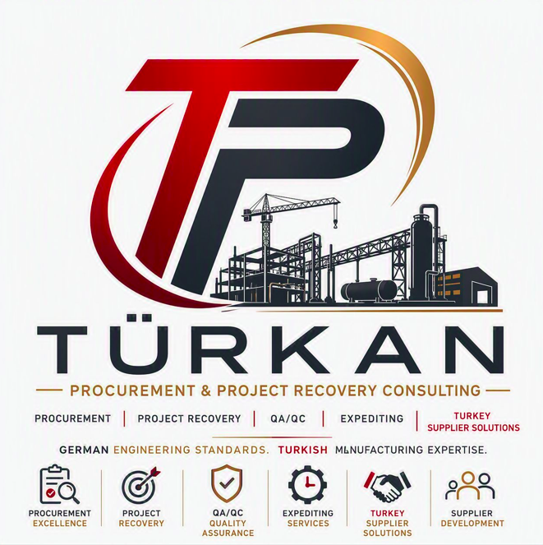
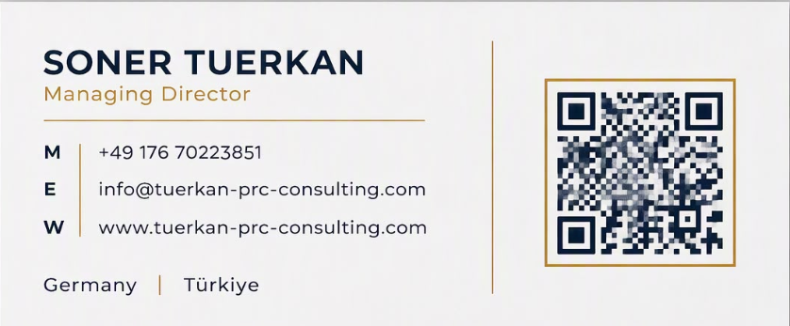
Tuerkan Procurement & Project Recovery
Trusted support for better procurement, lower risk, and project recovery.

Slide 2
What this presentation covers
01
04
Company overview
Case results and outcome examples
02
05
Services offered
Why clients choose us
03
06
Construction and engineering experience
Next steps

Slide 3
Company profile
A focused partner for procurement and project recovery
Procurement consulting
Improve sourcing, supplier decisions, and commercial discipline
We help clients strengthen procurement performance through practical support on packages, negotiations, and cost control.
Project recovery consulting
Stabilize underperforming work and restore delivery momentum
Senior consulting partner for procurement improvement and project recovery support across construction and engineering clients.
We support project recovery by clarifying priorities, reducing execution risk, and driving focused actions to regain control.
Construction and engineering focus
Procurement consulting support
Senior-level client support
Project recovery consulting support
Hands-on guidance tailored to each external client situation
Clients receive experienced, practical support that aligns commercial, delivery, and recovery decisions with business needs.
Tailored senior-level client support
We help clients improve procurement, reduce risk, and restore momentum.

Slide 4
Improve procurement and recover delivery
Practical services for construction and engineering clients
1
2
3
Procurement consulting
Project recovery advisory
Integrated client value
We help clients improve sourcing, tendering, supplier management, and commercial performance.
We diagnose delivery issues, restore governance, and drive corrective actions to stabilize projects.
Together, these services reduce cost and risk while improving supplier performance and control.
Sourcing and tender support
Rapid issue diagnosis
Lower cost and risk
Supplier performance control
Governance reset
Better schedule control
Commercial improvement focus
Corrective action delivery
Stronger project execution

Slide 5

Built for construction and engineering
Experience aligned to construction and engineering client realities
01
02
Complex supply chains and subcontracting need clear procurement control, supplier coordination, and commercial discipline across delivery.
Cost, schedule, and supplier performance move together across project lifecycles, so intervention must reflect both delivery and commercial pressure.
03
When schedules, costs, or coordination start to deteriorate, clients need fast diagnosis, practical recovery actions, and tighter execution discipline.

Slide 6
Outcome types clients can expect
High level proof themes with room for tailored evidence later
Procurement value
Project recovery
Custom proof points
Teams can capture measurable value through savings, better terms, and lower supplier risk where verified results are available.
Engagements can stabilize delivery, improve schedule discipline, restore governance, and strengthen cross functional coordination.
Named examples, sector references, and confirmed results can be added later once case material is validated for the opportunity.
Use credible outcomes now, then tailor proof with verified client evidence
This creates a persuasive story without overstating what has not yet been confirmed. As customization progresses, the same structure can absorb validated case results, sector context, and approved examples.

Slide 7
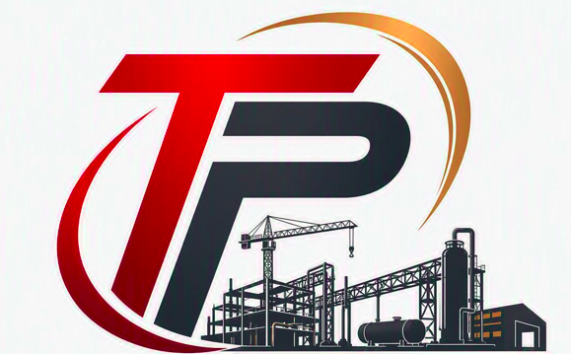
Illustrative case structure
Example format for future validated client proof
Illustrative structure for case examples
Challenge: Costs or supplier risk need improvement.
Intervention: Redesign sourcing and supplier oversight.
Challenge: A critical project is off track.
Intervention: Reset governance and restore cadence.
Result: Placeholder for outcome evidence.
Result: Placeholder for improvement evidence.

Slide 8
Why clients choose Tuerkan Procurement & Project Recovery
Practical problem solving
Procurement plus recovery
Why it works
Hands on support to resolve commercial and delivery issues with clear actions and accountable follow through.
Combined expertise links sourcing decisions with project recovery needs, so advice works in delivery reality.
A hands on partner, not abstract advice.
Integrated
Sector fit
Client value focus
Commercial and delivery expertise in one offer.
Built for construction and engineering environments where contracts, interfaces, and execution risk must align.
Results oriented work aimed at stronger outcomes, lower exposure, and decisions that matter to the client.
Relevant to complex project environments.
Client benefits
Focused on useful, client level outcomes.
Stronger procurement performance across key packages and decisions.
Lower cost and risk exposure through better commercial control.
Restored execution confidence for pressured projects and teams.
Clearer priorities and actions that support delivery results.

Slide 9

Next steps for discussion
A practical conversation focused on procurement improvement and project recovery needs
Ready to tailor the discussion
Tuerkan Procurement & Project Recovery Consulting UG supports construction and engineering clients with procurement improvement and project recovery. We would welcome a focused discussion on your priorities and where targeted support could add value.
Suggested next steps
1
2
3
Discuss priorities
Identify opportunities
Tailor scope and examples
Review current challenges in procurement, delivery, or recovery to clarify where support is most relevant.
Highlight the opportunity areas that matter most, from commercial improvement to project stabilization.
Align relevant case examples and a practical scope of support to your specific situation.

Slide 10
Thank you.

